Slide 1
Introduction to emerging database technologies LECTURER: Olivier Kevin ISHIMWE Email: kishimwe@uok.ac.rw

Slide 2
Emerging database technologies
Mobile Database.
Multimedia Database.
GIS ( Geographic Information Systems ).
Distributed database (own reading)

Slide 3
Mobile database
Portable devices and wireless technology led to mobile computing.
Portable computing devices and wireless communication allowed the client to access data from any where and any time.
A mobile database is a database that can be connected to by a mobile computing device over a mobile network. This database is portable and physically separate from the corporate database server.
Mobile Database is capable of communicating with that corporate database server from remote sites allowing the sharing of corporate database.

Slide 4
FEATURES OF MOBILE DATA BASE
Provide relational database services but require little memory
Analyze and manipulate data on a mobile device
Handle SQL queries on the road
Users can choose to
- Work online with a central DBMS server
- Download data & work on them
- Capture real-time data & Synchronize later
Are customized for mobile applications

Slide 5
APPLICATIONS OF MOBILE DATABASES
BUSINESS
Information on customers, competitors, and market trends – anytime, anywhere….
Salespersons can update sales & customer data on the move.
PUBLIC SECTOR
US Army uses mobile database technology to get current inventory and readiness info that can save them logistical costs.

Slide 6
Applications of mobile databases
HEALTH SECTOR
Used by Physicians to store and retrieve information while making their rounds.
Used by doctors & Para medics to retrieve vital patient history & treatment info while attending to patients in battle fields & remote accident locations..

Slide 7
DBMS FOR MOBILE DEVICES
DBMS’s for mobile device should be dedicated to optimizing at least one of the following, preferably both:
power optimization
memory management

Slide 8
POWER OPTIMIZATION
Mobile devices such as laptops, cell phones, PDA’s, and radios have a limited power supply.
So we needed to optimize our DBMS to use as few resources as possible while providing the necessary functionality
MEMORY MANAGEMENT
Memory is an important criteria as far as mobile database systems are concerned.
It is important to decide how much of the devices internal memory should be dedicated to the DB

Slide 9
MOBILE DATABASE ARCHITECTURE
For any mobile architecture, things to be considered are:
Users are not attached to a fixed geographical location
Mobile computing devices: low-power, low-cost, portable
Wireless networks
Mobile computing constraints

Slide 10
THREE PARTIES
Mobile databases architecture typically involve three parties:
FIXED HOSTS
MOBILE UNITS
BASE STATIONS

Slide 11
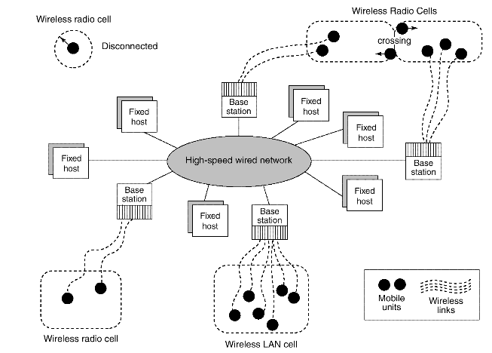

Slide 12
MOBILE DATABASE ARCHITECTURE
Fixed hosts perform the transaction and data management functions with the help of database servers.
Mobile units are portable computers that move around a geographical region that includes the cellular network (or "cells") that these units use to communicate to base stations. (Note that these networks need not be cellular telephone networks.)
Base stations are two-way radios, installations in fixed locations, that pass communications with the mobile units to and from the fixed hosts.
They are typically low-power devices such as mobile phones, portable phones, or wireless routers.

Slide 13
MOBILE DATABASE ARCHITECTURE
When a mobile unit leaves a cell serviced by a particular base station, that station transparently transfers the responsibility for the mobile unit's transaction and data support to whichever base station covers the mobile unit's new location

Slide 14
Mobile Database Systems(MDS) MARKET SHARE
Sybase SQL Anywhere dominates the mobile database field with over 68%.
IBM’s DB2 Everyplace is second market share holder.
Third place is shared by Microsoft’s SQL Server Compact and Oracle9i Lite.
Apple’s IOs use DataGlass mobile database by Impathic.

Slide 15
MOBILE DATABASE SYSTEM LIMITATIONS
Limited wireless bandwidth
Wireless communication speed
Limited energy source (battery power)
Less secured
Vulnerable to physical activities
Hard to make theft proof.

Slide 16
Multimedia Database Concepts
Multimedia databases provide features that allow users to store and query different types of multimedia information.
Multimedia Database Management System (MMDBMS)
MMDBMS is the host for storing, managing and retrieving media file types such as documents, images, audio, videos, etc.

Slide 17
Multimedia databases
The difference between Multimedia databases and standard databases is a multimedia database stores information and media ‘internally’ whereas a ‘normal’ database can only store textual or numerical data.

Slide 18
Types of multimedia data
Text: May be formatted or unformatted. For ease of parsing structured documents such as books or articles.
Graphics: Examples include drawings and illustrations that are encoded using some descriptive standards (e.g. CGM, PICT, postscript).
Images: Includes drawings, photographs, and so forth, encoded in standard formats such as bitmap, JPEG, and MPEG. Compression is built into JPEG and MPEG.
These images are not subdivided into components. Hence querying them by content (e.g., find all images containing circles) is nontrivial.
Animations: Temporal sequences of image or graphic data.

Slide 19
Types of multimedia data
Video: video clips such as movies, newsreels, or home videos. A set of temporally sequenced photographic data for presentation at specified rates– for example, 30 frames per second.
Structured audio: Audio clips such as songs, phone messages, or speeches. A sequence of audio components comprising note, tone, duration, and so forth.

Slide 20
Multimedia Applications
Multimedia applications dealing with thousands of images, documents, audio and video segments, and free text data depend critically on:
Appropriate modeling of the structure and content of data
Designing appropriate database schemas for storing and retrieving multimedia information.

Slide 21
Multimedia Database Applications
Documents and records management
Education and training
Marketing, advertising, retailing, entertainment, and travel
Real-time control and monitoring

Slide 22
Geographic information systems(GIS)
Meaning: A systematic integration of hardware and software for capturing, storing, displaying, updating manipulating and analyzing spatial data.
Geographic information systems(GIS) are used to collect, model, and analyze information describing physical properties of the geographical world.
Geographic Information Systems contain spatial information about cities, states, countries, streets, highways, lakes, rivers, and other geographical features, and support applications to combine such spatial information with non-spatial data.

Slide 23
The scope of GIS broadly encompasses two types of data:
spatial data, originating from maps, digital images, administrative and political boundaries, roads, transportation networks, physical data, such as rivers, soil characteristics, climatic regions, land elevations, and
non spatial data, such as socio-economic data (like census counts), economic data, and sales or marketing information. GIS is a rapidly developing domain that offers highly innovative approaches to meet some challenging technical demands.

Slide 24
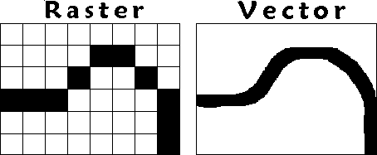
GIS data can be broadly represented in two formats:
Vector data represents geometric objects such as points, lines, and polygons.
Raster data is characterized as an array of points, where each point represents the value of an attribute for a real-world location.

Slide 25
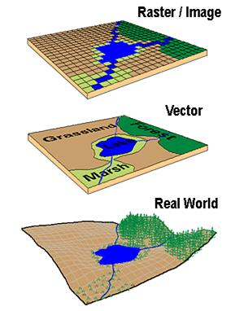

Slide 26
Specific GIS Data Operations
The functionality of a GIS database is also subject to other considerations:
• Extensibility
• Data quality control
• Visualization
Such requirements clearly illustrate that standard RDBMSs or ODBMSs do not meet the special needs of GIS.
Therefore it is necessary to design systems that support the vector and raster representations and the spatial functionality as well as the required DBMS features.

Slide 27
GIS APPLICATIONS
GIS Applications can be divided into three categories
cartographic applications-
By using GIS, cartographers are able to collect, store, and combine data about a given area, subject, or region being researched. This will help planners working on environmental to monitor change, predict trends and manage recourses using current relevant data
digital terrain modelling applications
A digital terrain model is a topographic model of the bare earth that can be manipulated by computer programs. (representation of part of the earth's surface)
geographic objects applications

Slide 28
